Slide 1
Where to eat in Gurgaon!!
Applied Data Science Capstone Project
Submitted by :
Vivek Chauhan

Slide 2
Introduction
Gurgaon ,officially known as Gurugram is a city located in the northern Indian state of Haryana. It is situated (19mi) to the southwest of national capital of New Delhi.
Today, Gurgaon has local offices for more than 250 Fortune 500 companies. Gurgaon is categorised as very high on the Human Development Index, with an HDI of 0.889 (2017), which is also the highest in India

Slide 3
Business Problem
To analyze and enable people to choose the best locality to stay based on their preferences in food.
Exploring best and worst places for specific cuisines.
Suggesting place for opening a “North Indian” cuisine serving place or hotels or other.

Slide 4
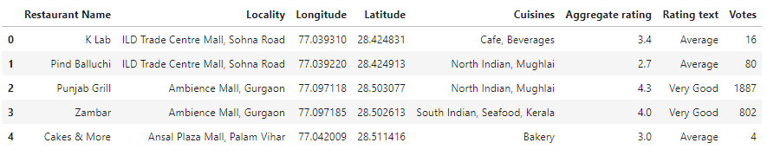
Data Acquisition and Data Cleaning
Data Sources:
Zomato Kaggle Dataset to explore localities in Gurgaon.
Foursquare API to explore venues in each neighborhood.
Gurgaon is served by 1118 restaurants described by 21 features ,data cleaning and feature selection was done.

Slide 5
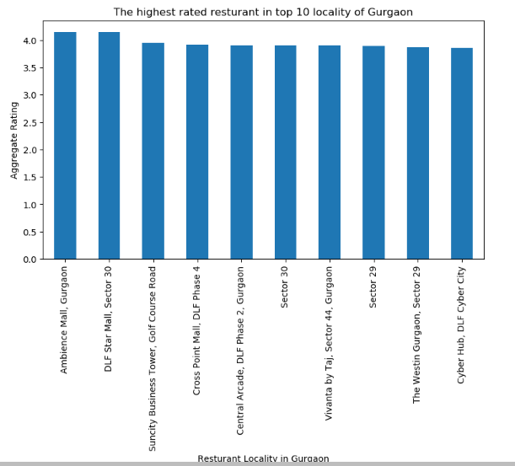
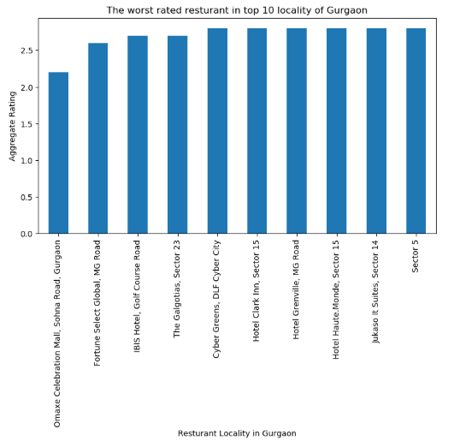
Methodology
EDA:
The highest rated restaurant
in top 10 locality of Gurgaon:
Lowest rated restaurant in top 10 locality of Gurgaon:

Slide 6
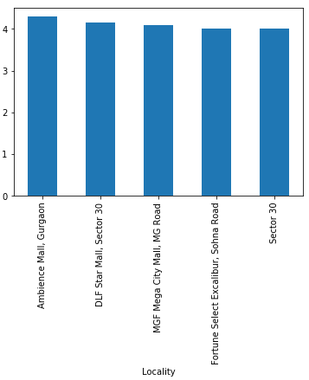
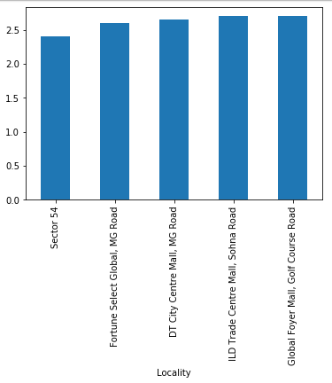
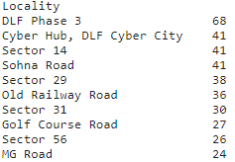
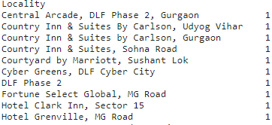
Localities having highest rated restaurant serving “North Indian” cuisines:
Localities having lowest rated restaurant serving “North Indian” cuisines:
Localities having most number of food places:
Localities having least number of food places:

Slide 7
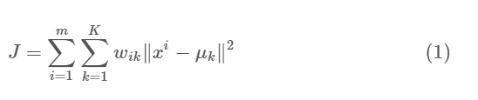
K-means clustering
K-means algorithm is an iterative algorithm that tries to partition the dataset into K pre -defined distinct non-overlapping subgroups (clusters) where each data point belongs to only one group. It tries to make the intra-cluster data points as similar as possible while also keeping the clusters as different (far) as possible.
The objective function is:

Slide 8
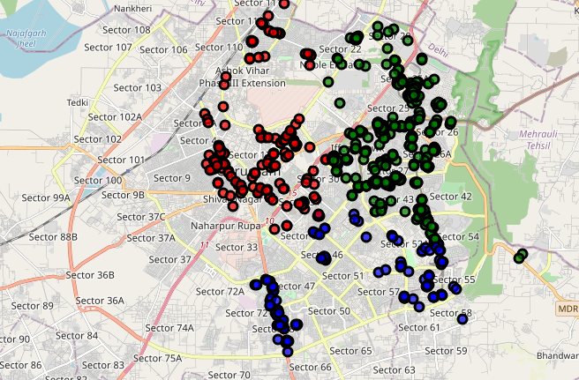
Results
Clustering based on location alone.(3 clusters)

Slide 9
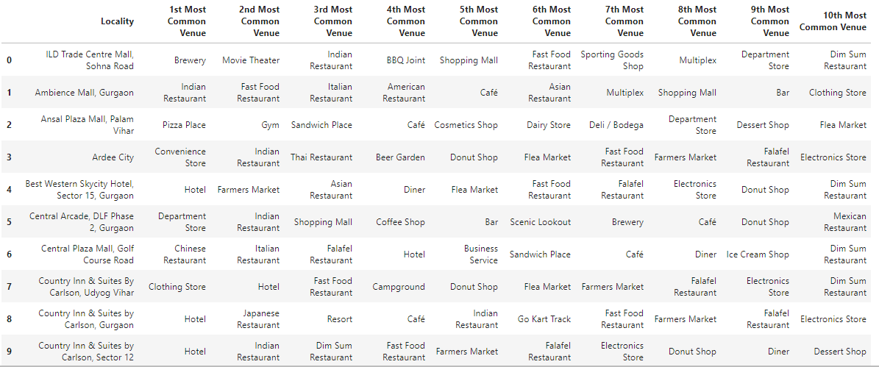
Exploring the most common venues around a place educates the person looking to buy/rent a place or open a food place.

Slide 10
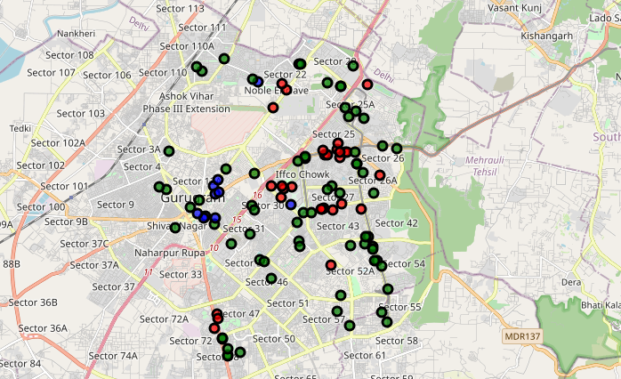
The clusters are formed on basis of similarity in cuisines available, location and common places near it. Hence if a person likes North Indian cuisines, he should rent a place in Cluster 1 around Sector 30 and ambience mall location and a person wanting to open a café place should target finding a place in Cluster 2 and cluster 3 is suitable for opening of hotels.
Cluster 1 : Green ,Cluster 2: Blue , Cluster 3 : Red

Slide 11
Conclusions
We performed EDA and clustering on these datasets in our pursuit of solutions. We were able to find satisfactory answers to the questions we posed before the study. The study is based on limited data, but it is nevertheless a significant step in shedding light on the hostel scene in Gurgaon. This study can be repeated easily for other cities of the world.

Slide 12
Future scope
Incorporating places available for rent/buy ,price and population turn up could be used to provide comprehensive list for suggesting places.
Comparative study such data for different cities to choose from.
Effect of corporate and work force could shed better light on trends for opening of new venture.

Slide 13
THANK YOU !!

